Slide 1
Length of Stay Project
Xiao Xu
8/10/2021

Slide 2
Project Overview
Background : For the last two years, Covid-19 Pandemic has affected whole medical industry and has raised alarms over one of the most overlooked area to focus: Healthcare Management.
While healthcare management has various use cases for using data analytics, patient length of stay is one critical parameter to observe and predict if one wants to improve the efficiency of the healthcare management.
Project Goal : The task is to accurately predict the Length of Stay for each patient on case-by-case basis so that the Hospitals and healthcare company can use this information to choose a better plan for the patients and optimize resource allocation.

Slide 3

Datasets
From
Contains 137058 patient’s public information such as patient_id, age, hospital_code, department, severity of illness, admission type etc.
Train.csv
Test.csv
Similar table with train.csv but for testing our model accuracy
Dictionary.csv
Detailed explanation about each column in train and test table.

Slide 4
Questions
What questions are you trying to solve?
What kind of data do we have and how do we treat different types?
What's missing from the data and how do you deal with it?
Where are the outliers and why should you care about them?

Slide 5
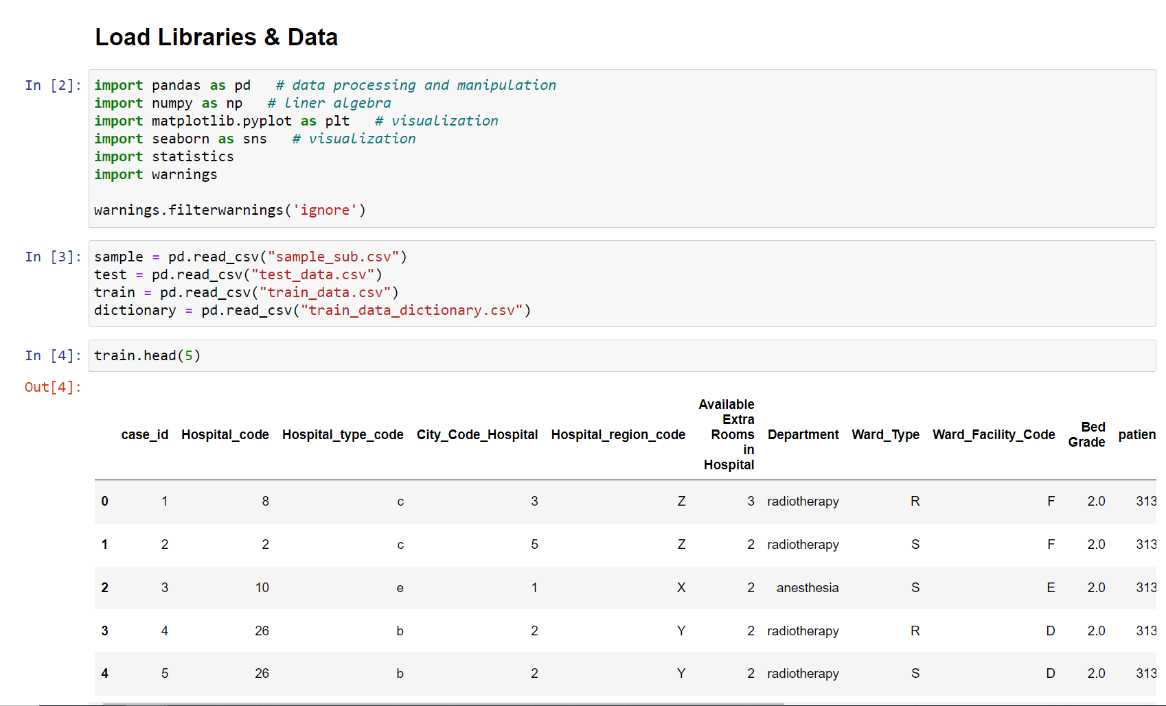
ETL
Load libraries & datasets
Environment: Python 3.6
Package:
Pandas (ETL)
Numpy (Data Manipulation)
Matplotlib (Visualization)
Seaborn (Visualization)
Statistics
Sklearn (Modeling)

Slide 6
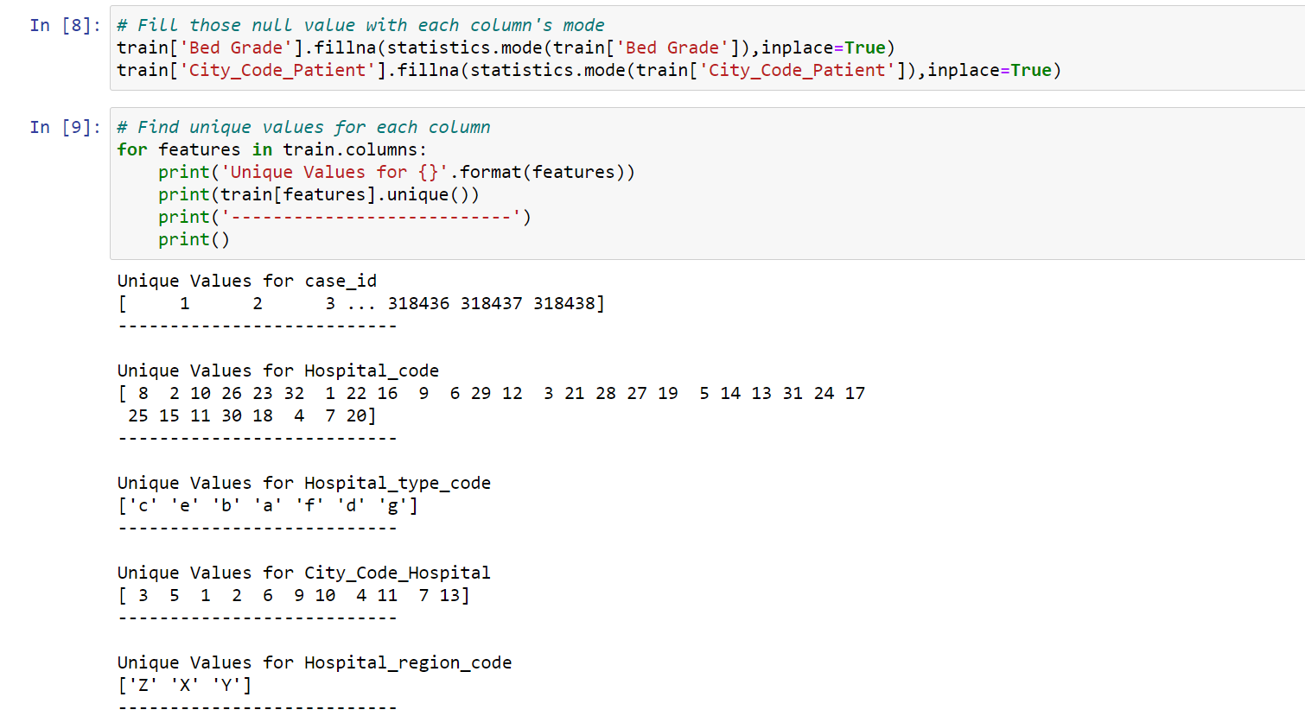
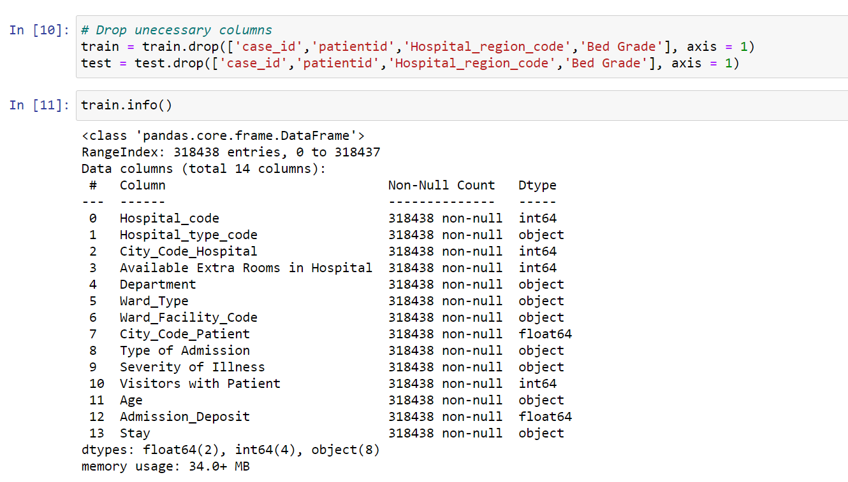
ETL
Fill null values and check unique values
Drop unnecessary data

Slide 7
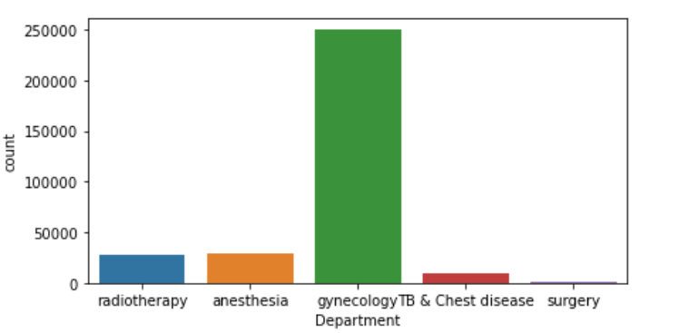
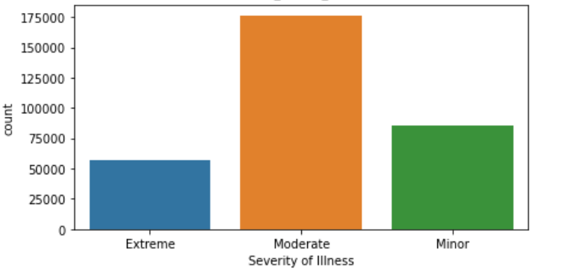
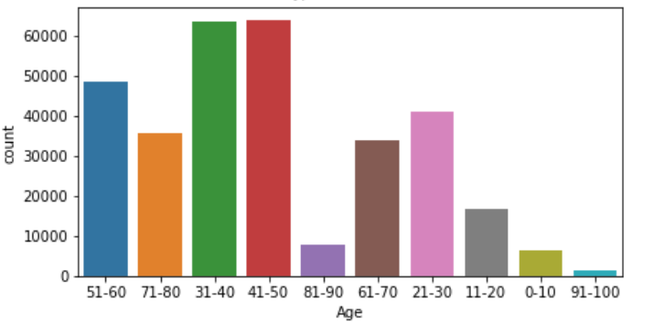
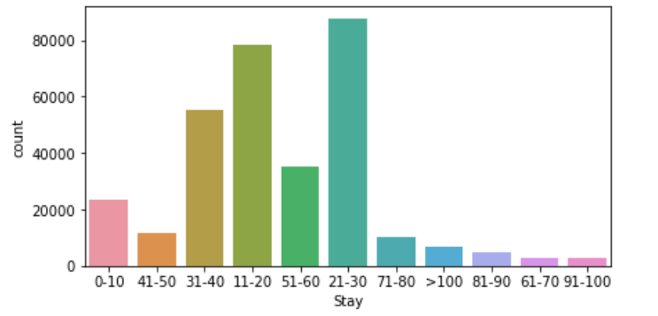
Exploratory Data Analysis (EDA)

Slide 8
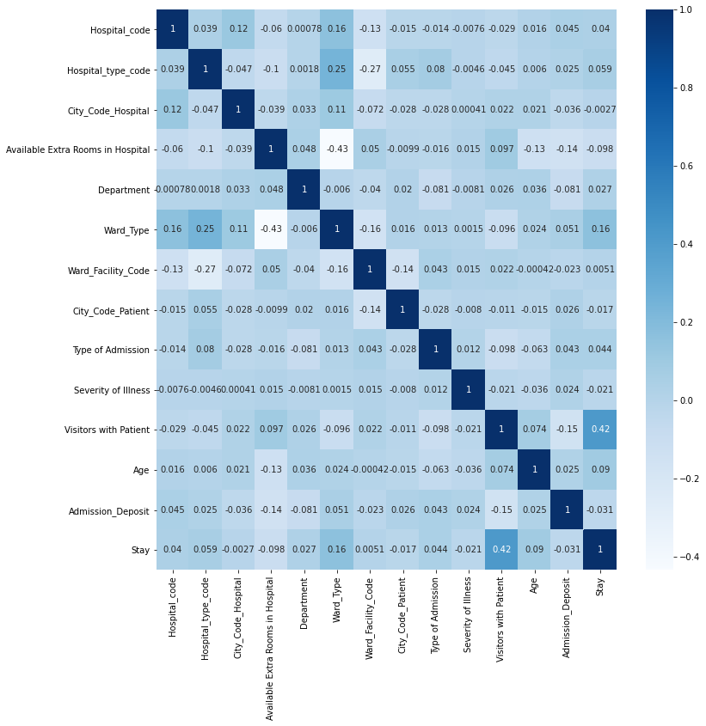
Exploratory Data Analysis (EDA)
This heatmap show the correlation between each variables.

Slide 9
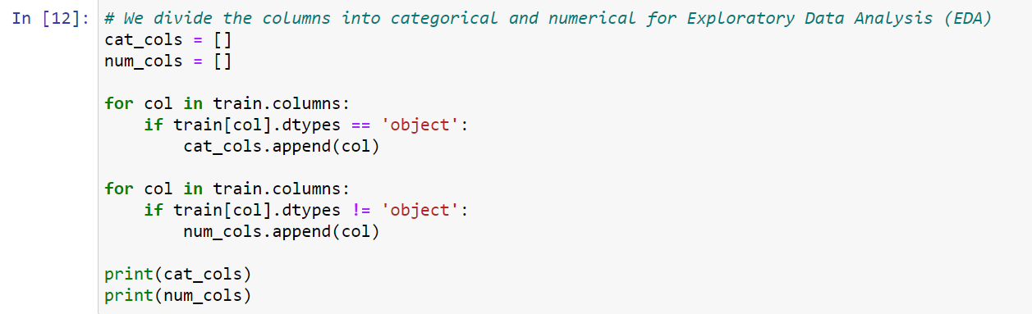
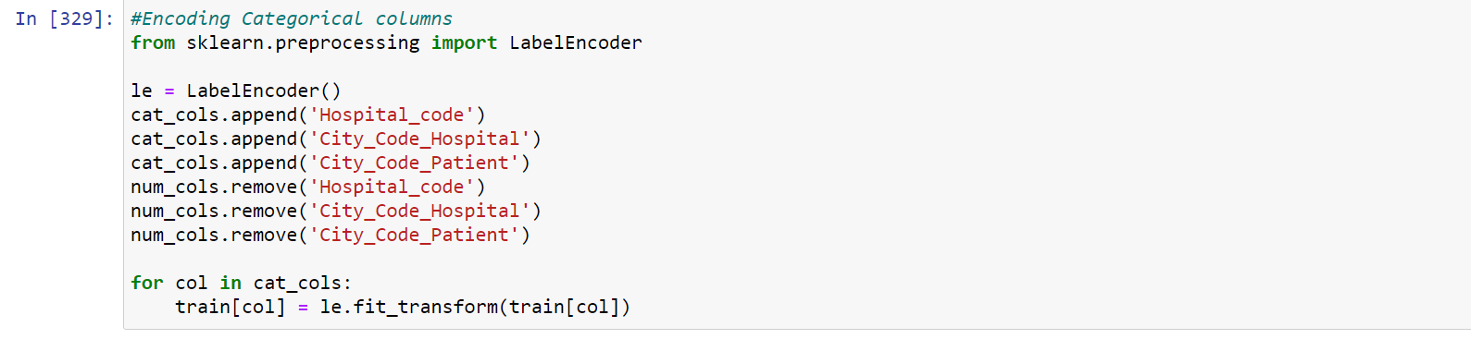
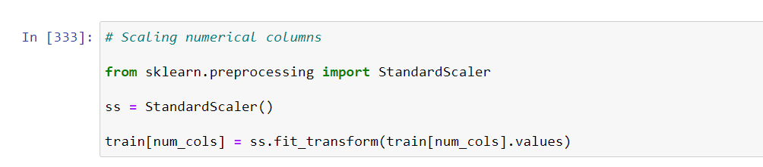
Data processing
Divide columns into categorical and numerical columns
Encoding categorical columns
Scaling numerical columns

Slide 10
Feature Selection
Avoid choosing variables has multicollinearity problem
Avoid categorical variable with too many unique values
Do not make the model too complex (Overfitting)

Slide 11
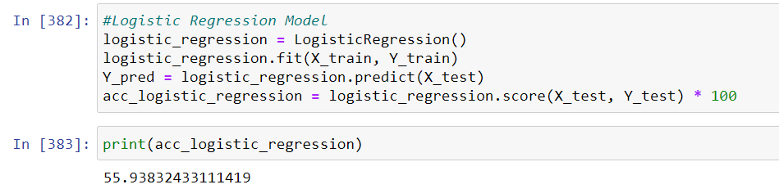
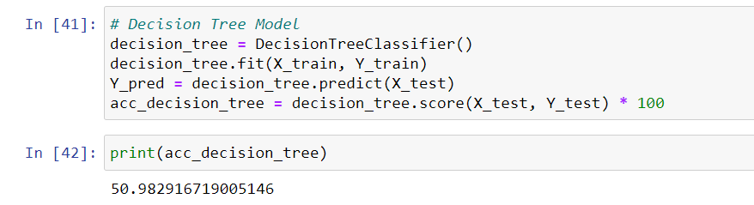
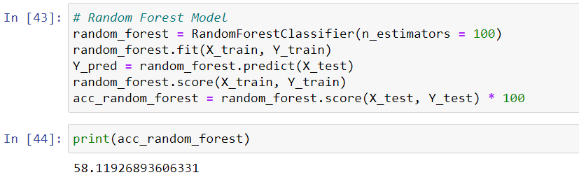
Model Accuracy
Logistic Regression Model
Prediction Accuracy: 55.93%
Decision Tree Model
Prediction Accuracy: 50.98%
Random Forest Model
Prediction Accuracy: 58.11%

Slide 12
Thoughts & Notes
Always focus on the goal of the task
2. Try as much as you can within deadline
3.Follow the industry standard & code and respect patient’s privacy

